Slide 1
Multinational Management In A Changing World

Slide 2
Learning Objectives
Define multinational management.
Understand the characteristics of a multinational company.
Understand the nature of the global economy and the key forces that drive globalization.
Know the basic classification of the world’s economies.
Identify the characteristics of the next generation of multinational managers.

Slide 3
The Definition of
Multinational Management
The formulation of strategies and management systems to take advantage of international opportunities and respond to international threats

Slide 4
The Nature of The Multinational Company
A multinational company is any company that engages in business functions beyond its domestic borders.
Such companies may be large or small.
Most multinational companies (MNCs) are multinational corporations.
The largest MNCs are all public corporations.

Slide 5
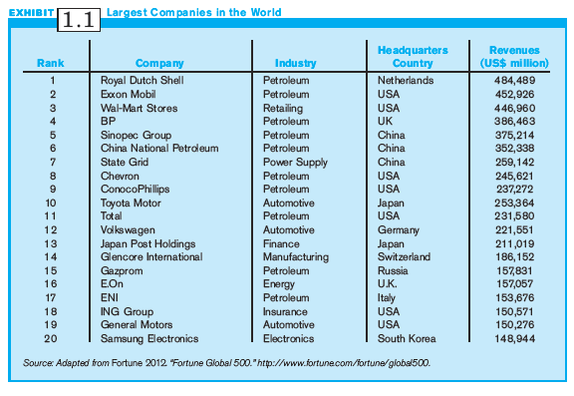
Exhibit 1.1:
Largest Companies in the World

Slide 6
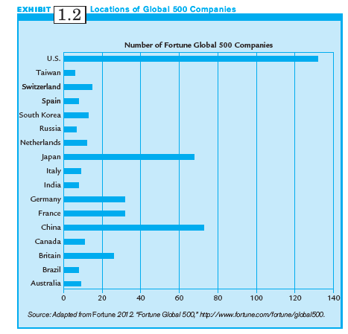
Exhibit 1.2:
Locations of
Global 500 Companies

Slide 7
The Globalizing Economy
Globalization: the world’s economies are becoming borderless and interlinked.
Companies are no longer limited by their domestic boundaries, and may conduct any kind of business activity anywhere in the world.
Globalization creates a changing, but not uniform, and not always stable, environment for business.

Slide 8
Negatives of Globalization
Not all economies of the world are benefiting equally or participating equally in the process.
Terrorism, wars, and a worldwide economic stagnation have limited or reversed some aspects of globalization.
Globalization produces a scarcity of natural resources, environmental pollution, negative social impacts, and increased interdependence of the world’s economies.
Globalization may be widening the gap between rich and poor countries.

Slide 9
The Benefits of Globalization
Globalization results in lower prices in many countries, as multinationals become more efficient.
Globalization benefits many emerging markets such as India and China, as these countries enjoy greater availability of jobs and better access to technology.
Globalization is the major reason why many new companies from Mexico, Brazil, China, India, and South Korea are the new dominant global competitors.

Slide 10
The Globalizing Economy:
7 Key Trends
Falling, disintegrating borders
Growing cross-border trade and investment
The rise of global products and global customers
The internet and information technology (IT)
Privatizations of formerly government-owned firms
New competitors in the world market
The rise of global standards for quality and production

Slide 11
Countries of the World:
The Arrived, The Coming, and The Struggling (1 of 4)
Developed Countries (the Arrived) have mature economies with substantial per capita Gross Domestic Product (GDP), international trade and investments.
  E.g., the United States of America, Britain, Japan, Germany, and many others

Slide 12
Countries of the World:
The Arrived, The Coming, and The Struggling (2 of 4)
Developing Countries/Regions (the Coming) have economies that have grown extensively over past two decades.
  E.g., Hong Kong, Singapore, Taiwan, Malaysia, Indonesia, Thailand.

Slide 13
Countries of the World:
The Arrived, The Coming, and The Struggling (3 of 4)
Transition economies (the Coming) are countries that have changed from mostly communist systems to market/capitalistic systems.
  E.g., the Czech Republic, Hungary, Poland, Russia

Slide 14
Countries of the World:
The Arrived, The Coming, and The Struggling (4 of 4)
Emerging Markets (the Coming) are those countries whose economies are growing rapidly.
  E.g., Brazil, Russia, India, & China (BRIC)

Slide 15
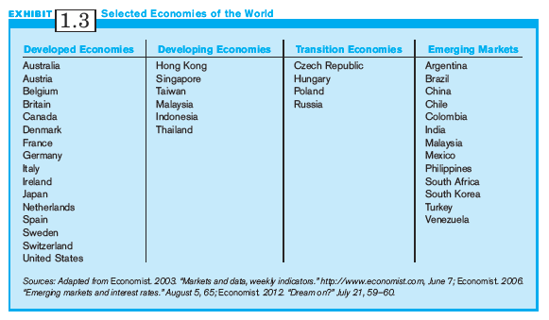
Exhibit 1.3:
Selected World Economies

Slide 16
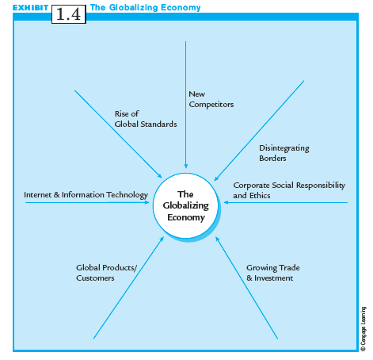
Exhibit 1.4:
The Globalizing Economy

Slide 17
Borders are Disintegrating: The World Trade Organization (WTO)
  In 1947, nations met to reduce tariffs from 45% to less than 7%; these negotiations resulted in the General Agreement on Tariffs and Trade (GATT).
  In 1986, negotiations began in Uruguay to continue reducing tariffs. The World Trade Organization (WTO) succeeded GATT.
  WTO provides structure for continued negotiations and settling trade disputes among nations.

Slide 18
World Trade Organization
In 1997, WTO countries agreed to end tariffs on software, computers and related products; hi-tech exports to Europe from Asia and the US doubled.
Since GATT, world trade has grown at more than four times the output of the world’s GDP.
Some say WTO favors developed nations, encourages environmental damage, and moves jobs from higher-save countries to lower-wage countries.

Slide 19
Regional Trade Agreements
(1 of 2)
Regional Trade Agreements are agreements among nations to reduce tariffs and develop similar technical and economic standards.
The three largest account for half the world’s trade:
  the European Union (EU)
  the North American Free Trade Association (NAFTA), and
  the Asia-Pacific Economic Cooperation (APEC)

Slide 20
Regional Trade Agreements
(2 of 2)
The European Union (27 European nations, and growing) allows free movement of goods and services and a common currency (EMU).
The North American Free Trade Agreement (NAFTA) linking the US, Canada, and Mexico, allows the freer exchange of goods and services.
The Asia-Pacific-Economic Cooperation (12 Asian nations) with goals for free trade by 2020.

Slide 21
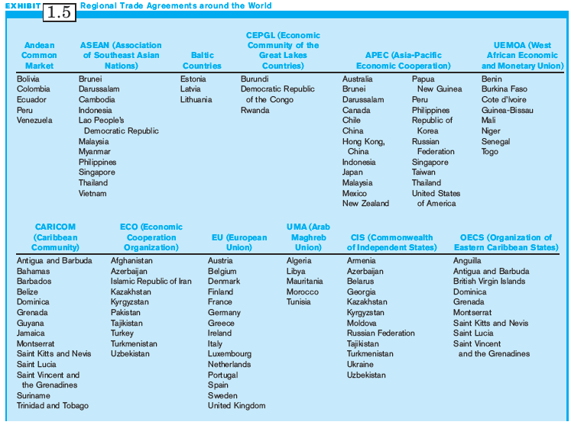
Exhibit 1.5:
Major Regional Trade Agreements

Slide 22
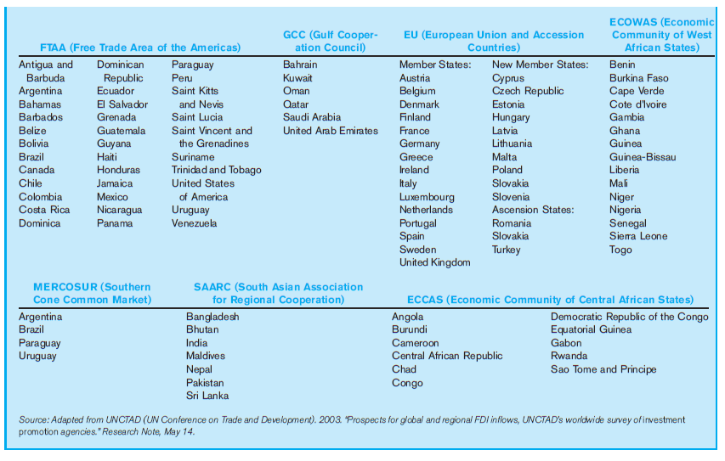
Exhibit 1.5:
Major Regional Trade Agreements

Slide 23
Sell Anywhere, Locate Anywhere: Trade Growing, but Setbacks
World trade grew an average of 6.5% per year between 1990 and 2000, slowed to 4% in 2004, grew again to 6% in 2005 and to 8.5% in 2006.
WTO reports the global economy is suffering from a very severe slowdown.
EU countries are suffering the worst debt crisis they have ever faced.
Change in imports & exports higher for developing and emerging economies than for developed economies.

Slide 24
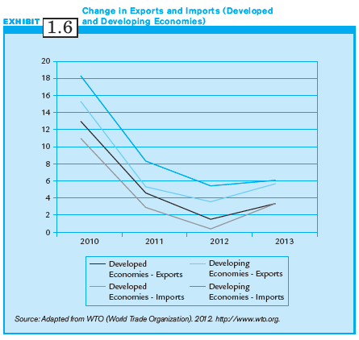
Exhibit 1.6:
Change in Exports & Imports

Slide 25
Sell Anywhere, Locate Anywhere: Foreign Direct Investment (FDI)
Foreign Direct Investment (FDI) occurs when a multinational company from one country has an ownership position in an organizational unit located in another country.
FDI increased by more than 36% from 1996 - 2000.
Since 2001, there has been a decline in FDI, but will probably resume its steady growth.
Emerging markets will continue to attract FDI.

Slide 26
Foreign Direct Investment
Developing countries provide opportunities and risks.
MNCs should consider two types of risk:
  Economic risk: includes all factors of a nation’s economic climate that may affect a foreign investor.
  Political risk: anything a government might do or not do that might adversely affect a company.

Slide 27
The Internet and Information Technology (1 of 2)
Email and the internet allow multinationals to communicate with company sites throughout the world.
Text and graphic information can flow to any part of the world almost instantaneously.
Headquarters, R&D, manufacturing can be located anywhere in the world.
Information technology is spurring a borderless financial market.

Slide 28
The Internet and Information Technology (2 of 2)
Information technologies make available many new tools that facilitate business operations:
  Worldwide communication using Voice-Over-Internet Protocol (VOIP) systems such as Skype, MSN Messenger and AOL is cost-effective.
  Collaborative networks can be provided by WIKI firms at very low cost.
  Information can be obtained by increasingly sophisticated search engines like Google.

Slide 29
The Rise of Global Products and Global Customers
The needs of customers for many products and services are growing more similar
  E.g., McDonald’s, Boeing, Toyota.
Global customers search the world for their supplies without regard for national boundaries.
These factors link economies because companies can produce one product for everyone, and anyone can buy anything from anywhere.

Slide 30
New Competitors (1 of 2)
Free market reforms are creating a potential group of new competitors.
These companies have survived brutal competition in local markets, and are able to deal with competition from western MNCs.
They have developed strategies to generate profits at very low prices.

Slide 31
New Competitors (2 of 2)
Global trade has two important effects in developing new competitors:
  When developing countries are used as low-wage platforms for high-tech assembly, multinationals facilitate the transfer of technology. Assemblers may become builders and creators of technology.
  Aggressive multinationals from emerging markets are also expanding beyond their own borders.

Slide 32
The Rise of Global Standards (1 of 2)
When a product standard is accepted globally or regionally, companies can make one or only a few versions of a product for the world market rather than hundreds.
Products are developed to accommodate different regional standards, such as electrical currents & plugs.
The company that can establish its standard as dominant has a tremendous strategic advantage.

Slide 33
The Rise of Global Standards (2 of 2)
The drive for consistency in quality led to the International organization for standardization (ISO) in Geneva, Switzerland.
ISO developed technical standards known as ISO 9001:2000, adopted by law in Europe.
Many large European MNCs now require ISO certification.

Slide 34
Corporate Social Responsibility and Business Ethics (1 of 2)
Despite their size and clout, MNCs face increased pressure to be socially responsible from both the media and the public.
Mindful of rankings on ethics, proactive MNCs pay close attention to these issues, and take appropriate action.

Slide 35
Corporate Social Responsibility and Business Ethics (2 of 2)
Some MNCs are becoming more proactive in responding to social and ethical issues that arise from their overseas operations.
Some issues are:
  Climate change
  Environmental degradation and pollution
  Sweatshop conditions for labor
  Bribery

Slide 36
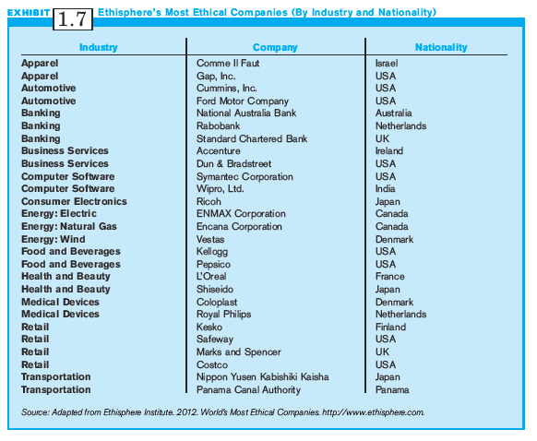
Exhibit 1.7:
Ranking the World’s
Most Ethical Companies

Slide 37
The Next Generation of Multinational Managers (1 of 2)
The successful Multinational Manager needs these characteristics:
  A global mindset
  Emotional intelligence
  A long-range perspective
  The talent to motivate all employees to achieve excellence

Slide 38
The Next Generation of Multinational Managers (2 of 2)
Characteristics of the successful Multinational Manager (continued):
  Accomplished negotiation skills
  A willingness to seek overseas assignments
  An understanding of national cultures

Slide 39
Multinational Management:
A Strategic Approach
You may well find yourself a multinational manager; foreign competition and doing business in foreign markets are daily facts of life for today’s managers.
Competing successfully requires a strategic approach; formulate and implement your strategy.
Multinational strategies must include maneuvers that deal with operating in more than one country and culture.
Position yourself for an evolving global economy.

Slide 40
Trends Shaping The
Future Business Environment
In formulating your strategy, consider the trends that will shape the future business environment:
  Blurring of industry boundaries
  The need for flexibility more than size
  The need to find your niche
  Hypercompetition
  Emphasis on innovation and the learning organization

Slide 41
Summary
key background information to support study of multinational management is discussed.
World economies are increasingly linked, creating both threats and opportunities.
New competitors are coming from developing nations in Asia, the Americas, and Eastern Europe.
Multinational managers need a global mindset, and strategies for succeeding in different nations and cultures.

